Slide 1
DBMS Integrity Constraints

Slide 2
Integrity constraints are a set of rules. It is used to maintain the quality of information.
Integrity constraints ensure that the data insertion, updating, and other processes have to be performed in such a way that data integrity is not affected.
Thus, integrity constraint is used to guard against accidental damage to the database.

Slide 3
Constraints are the rules enforced on the data columns of a table.
These are used to limit the type of data that can go into a table.
This ensures the accuracy and reliability of the data in the database.
Constraints could be either on a column level or a table level.
The column level constraints are applied only to one column, whereas the table level constraints are applied to the whole table.

Slide 4
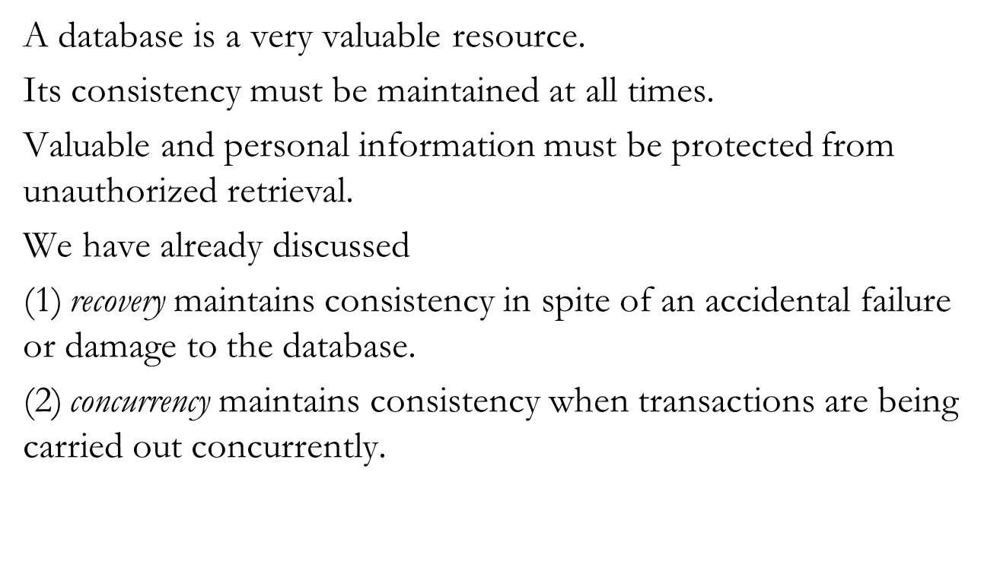
Integrity Constraints: Integrity

Slide 5
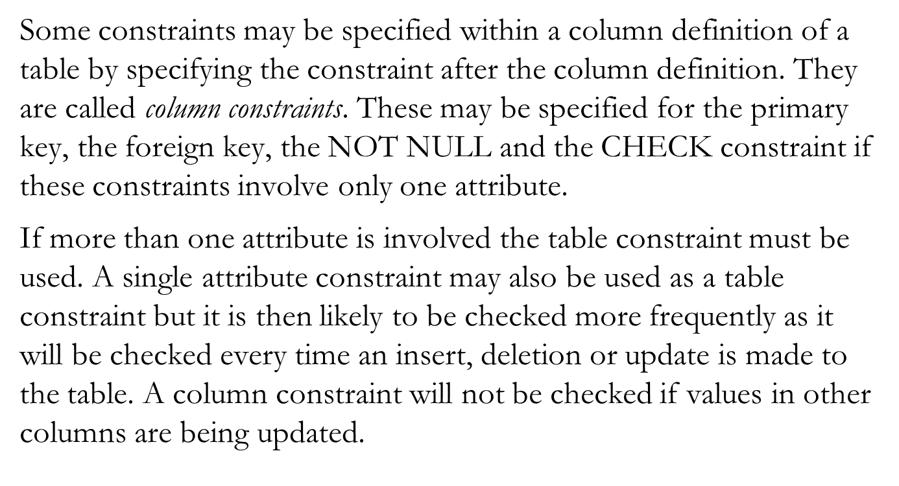
Column and table constraints

Slide 6
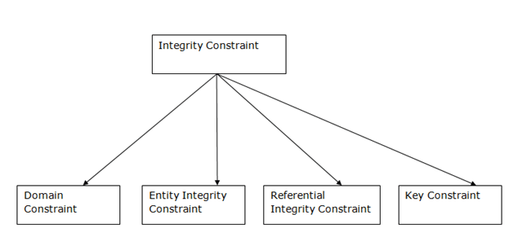
Types of Integrity Constraint

Slide 7
1. Domain Integrity Constraints
Not Null Constraint
Check Constraint
Default Constraint

Slide 8
2. Entity Integrity Constraints
Primary key constraint
Unique constraint

Slide 9
3.Refrential Integrity Constraints
Foreign key constraint

Slide 10
NOT NULL Constraint − Ensures that a column cannot have NULL value.
DEFAULT Constraint − Provides a default value for a column when none is specified.
UNIQUE Constraint − Ensures that all values in a column are different.

Slide 11
PRIMARY Key − Uniquely identifies each row/record in a database table.
FOREIGN Key − Uniquely identifies a row/record in any of the given database table.
CHECK Constraint − The CHECK constraint ensures that all the values in a column satisfies certain conditions.

Slide 12
1. Domain Integrity (Not Null)
This constraint ensures all rows in the table contain a definite value for the column which is specified as not null.
Which means a null value is not allowed.
By default, a column can hold NULL values.
If you do not want a column to have a NULL value, then you need to define such a constraint on this column specifying that NULL is now not allowed for that column.
A NULL is not the same as no data, rather, it represents unknown data.

Slide 13
Example
CREATE TABLE employee ( id number(5), name char(20) NOT NULL, dept char(10), age number(2), salary number(10), location char(10) );

Slide 14
One more example
CREATE TABLE CUSTOMERS(
ID INT NOT NULL,
NAME VARCHAR (20) NOT NULL,
AGE INT NOT NULL,
ADDRESS CHAR (25) ,
SALARY DECIMAL (18, 2),
PRIMARY KEY (ID) );

Slide 15
If CUSTOMERS table has already been created, then to add a NOT NULL constraint to the SALARY column
ALTER TABLE CUSTOMERS MODIFY Age INT NOT NULL;

Slide 16
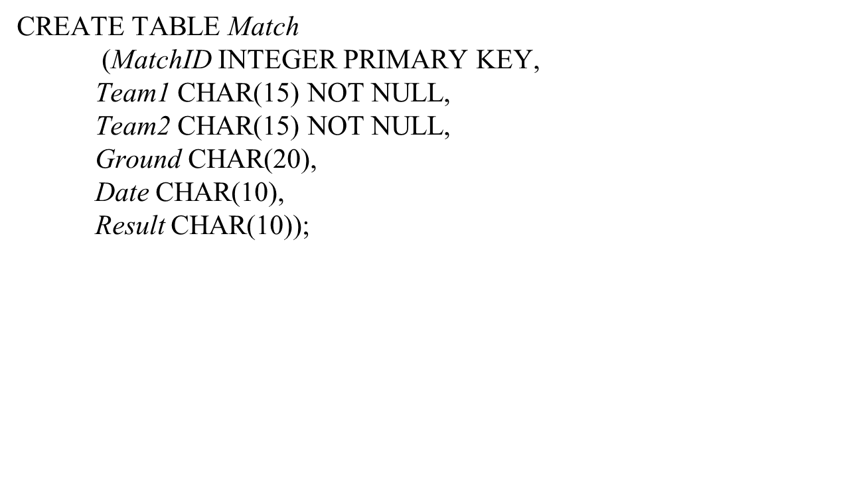
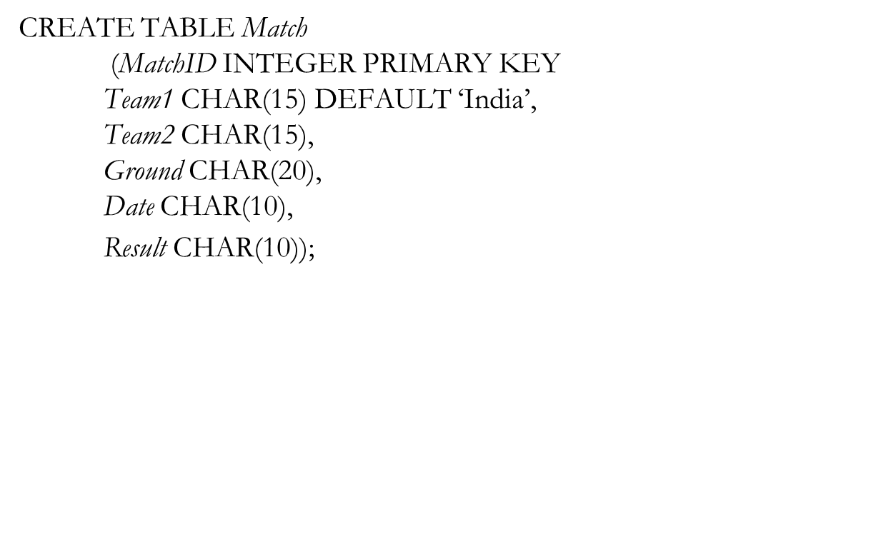
Not Null and default as column constraints

Slide 17
1. Domain Integrity (Check)
Using this constraint, we can specify a condition for a field, which should be satisfied at the time of entering values for this field.
CREATE TABLE Student
(
ID int(6) NOT NULL,
NAME varchar(10) NOT NULL,
AGE int NOT NULL CHECK (AGE >= 18)
)

Slide 18
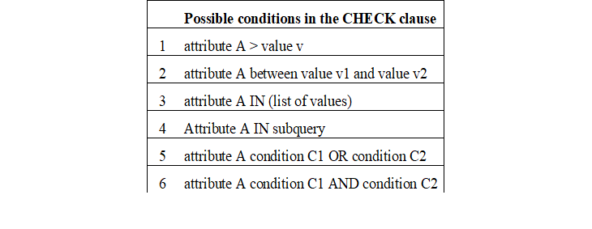
Check Constraints

Slide 19
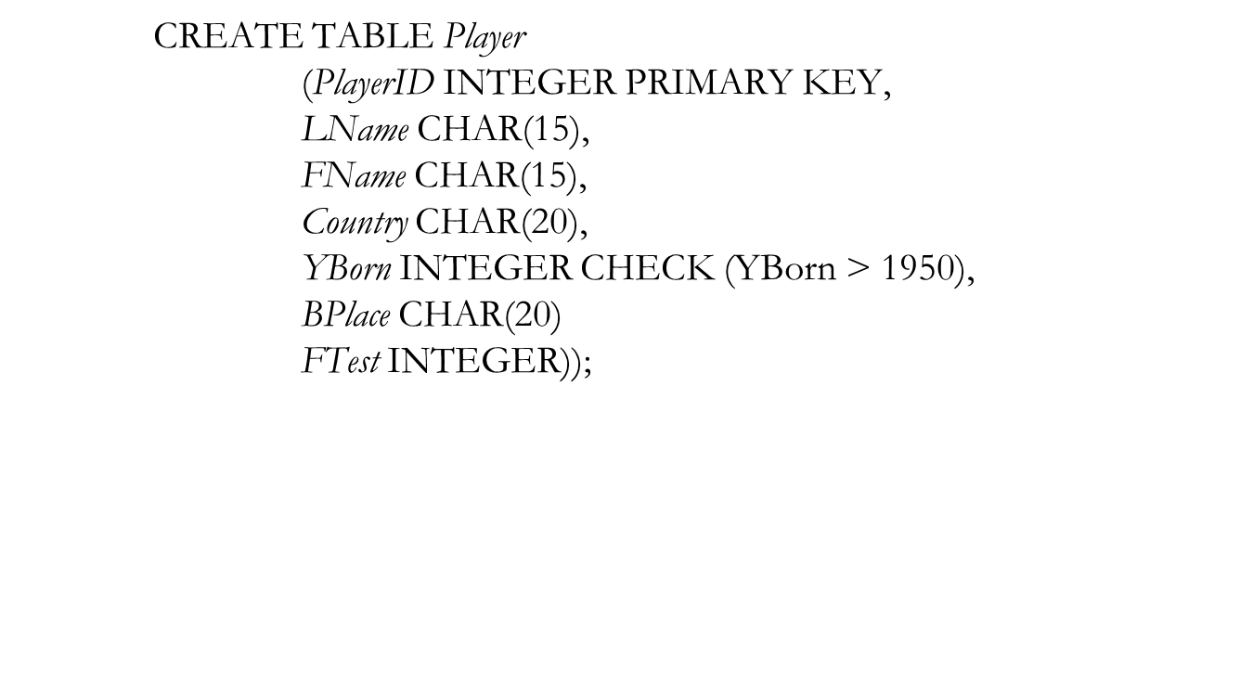
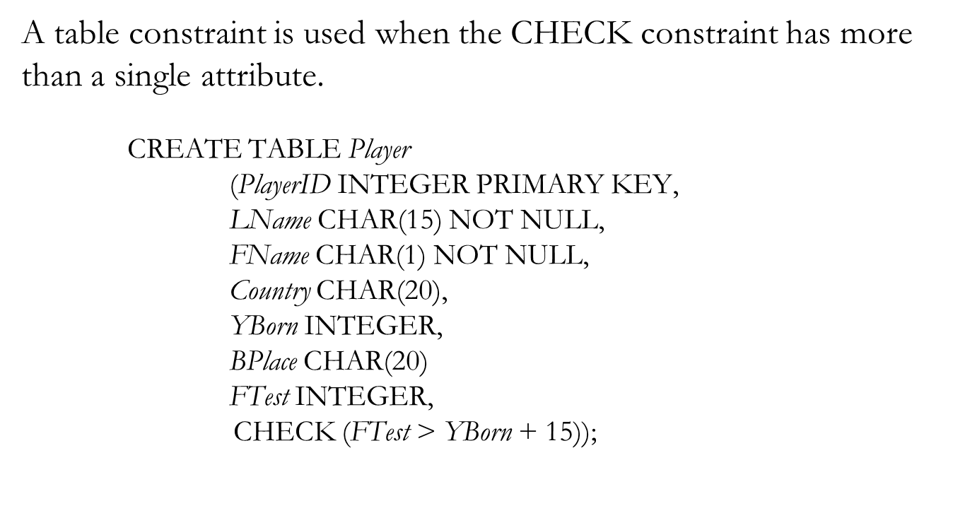
Check as Column and Table Constraints

Slide 20
ALTER TABLE Persons ADD CHECK (Age>=18);

Slide 21
CREATE TABLE employee
( id number(5) PRIMARY KEY,
name char(20),
dept char(10),
age number(2),
gender char(1) CHECK (gender in ('M','F')),
salary number(10),
location char(10)
);

Slide 22
1. Domain Integrity (Default)
The DEFAULT constraint provides a default value to a column when the INSERT INTO statement does not provide a specific value.

Slide 23
For example, the following SQL creates a new table called CUSTOMERS and adds five columns. Here, the SALARY column is set to 5000.00 by default, so in case the INSERT INTO statement does not provide a value for this column, then by default this column would be set to 5000.00.

Slide 24
CREATE TABLE CUSTOMERS(
ID INT NOT NULL,
NAME VARCHAR (20) NOT NULL,
AGE INT NOT NULL,
ADDRESS CHAR (25) ,
SALARY DECIMAL (18, 2) DEFAULT 5000.00,
PRIMARY KEY (ID)
);

Slide 25
CREATE TABLE Persons (
ID int NOT NULL,
LastName varchar(255) NOT NULL,
FirstName varchar(255),
Age int,
City varchar(255) DEFAULT ‘Mumbai');

Slide 26
CREATE TABLE Student
(
ID int(6) NOT NULL,
NAME varchar(10) NOT NULL,
AGE int DEFAULT 18
);

Slide 27
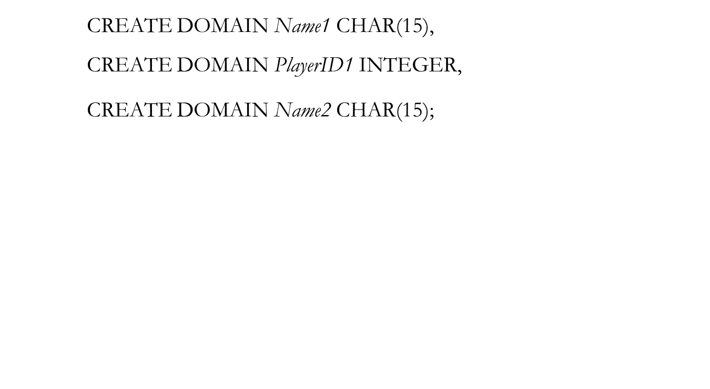
Domain constraints

Slide 28
2.Entity Integrity (Primary Key)
Primary Key in SQL is a field which uniquely identifies each row in the table, it is the combination of NOT NULL and UNIQUE SQL Constraints.
If a field in a table is specified as a primary key, then the field can not contain NULL values.
Also for this field, the rows should contain unique values.

Slide 29
A primary key is a field in a table which uniquely identifies each row/record in a database table.
Primary keys must contain unique values. A primary key column cannot have NULL values.

Slide 30
CREATE TABLE Student
(
ID int(6) NOT NULL UNIQUE,
NAME varchar(10),
ADDRESS varchar(20),
PRIMARY KEY(ID)
);

Slide 31
CREATE TABLE Persons (
ID int NOT NULL PRIMARY KEY,
LastName varchar(255) NOT NULL,
FirstName varchar(255),
Age int
);

Slide 32
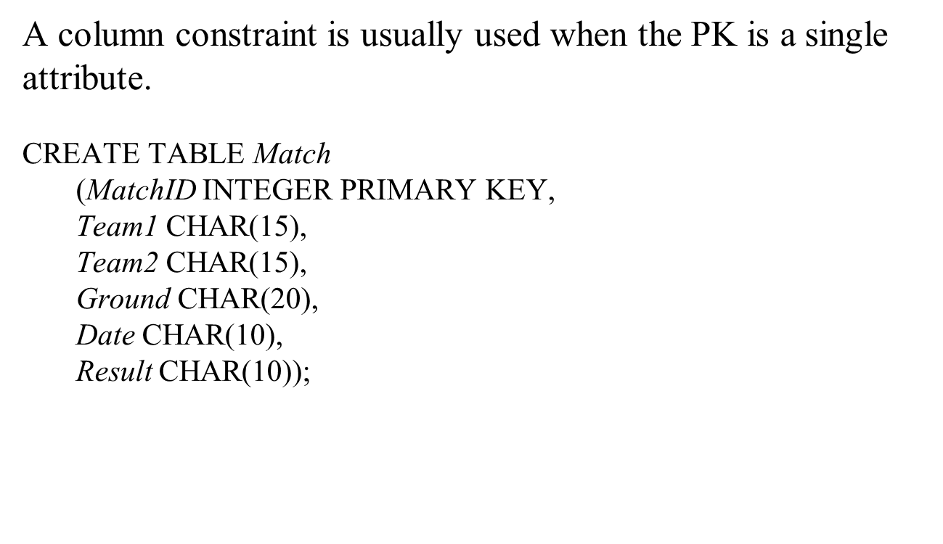
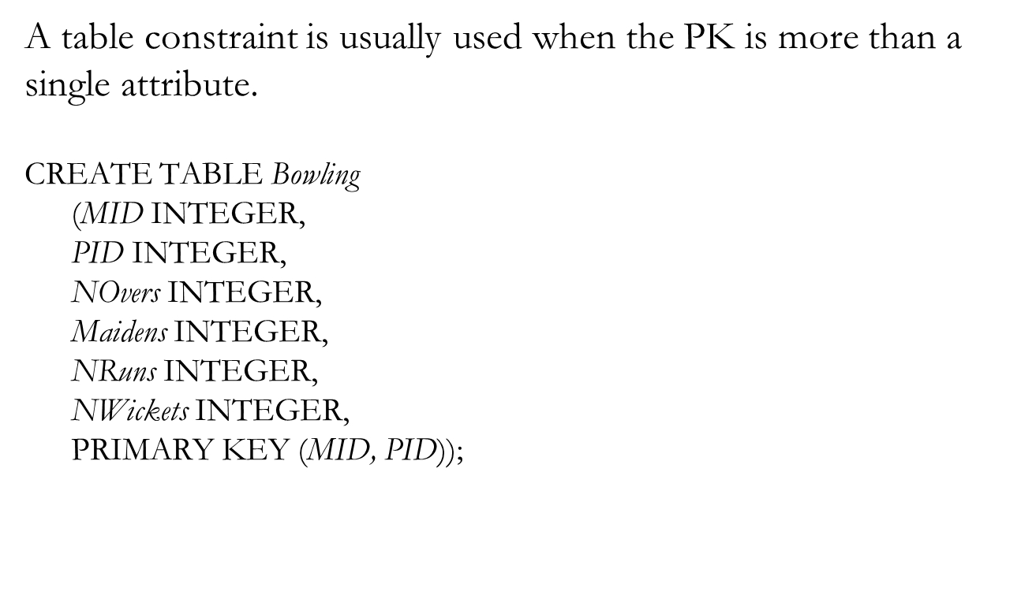
Primary key as column and table constraints

Slide 33
2.Entity Integrity (Unique)
The unique SQL constraint helps to identify each row uniquely, which means a particular column and rows should have unique values. One or more columns can be unique.

Slide 34
CREATE TABLE Student
(
ID int(6) NOT NULL UNIQUE,
NAME varchar(10),
ADDRESS varchar(20)
);

Slide 35
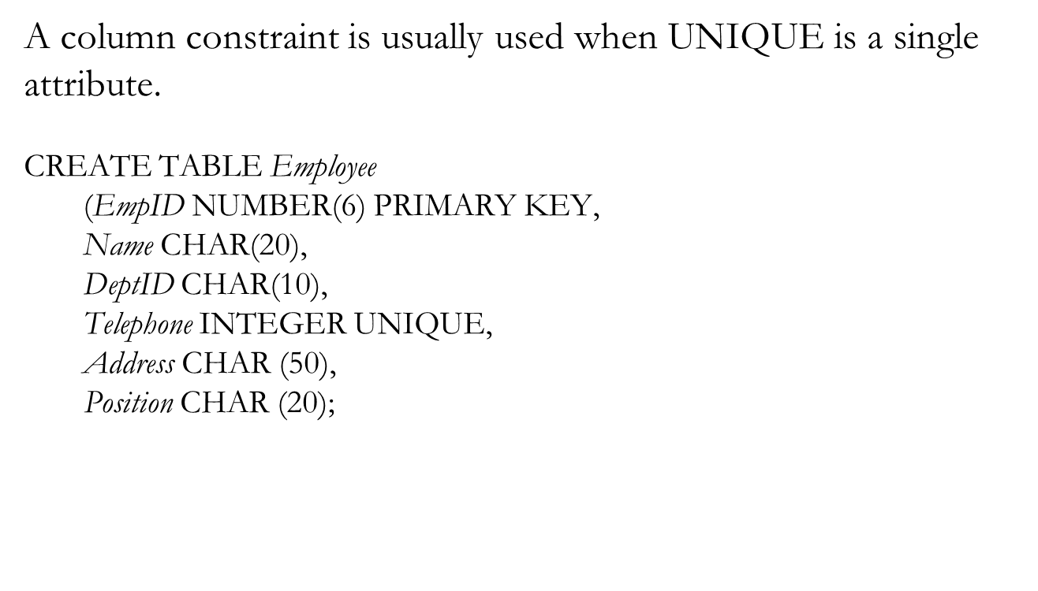
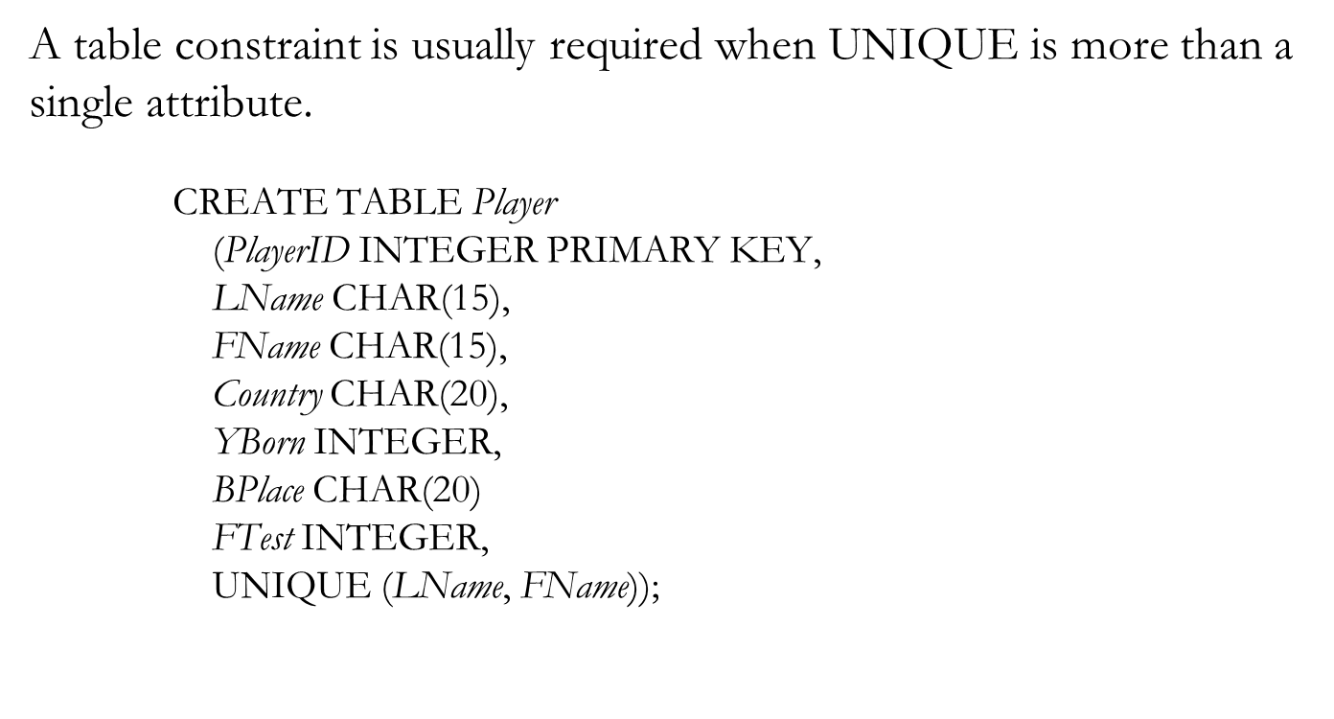
Unique as column and table constraints

Slide 36
3. Referential Integrity
SQL Foreign Key is a field in a table which uniquely identifies each row of another table,
which means this field points to the primary key of another table, thus creating a link between the two tables.

Slide 37
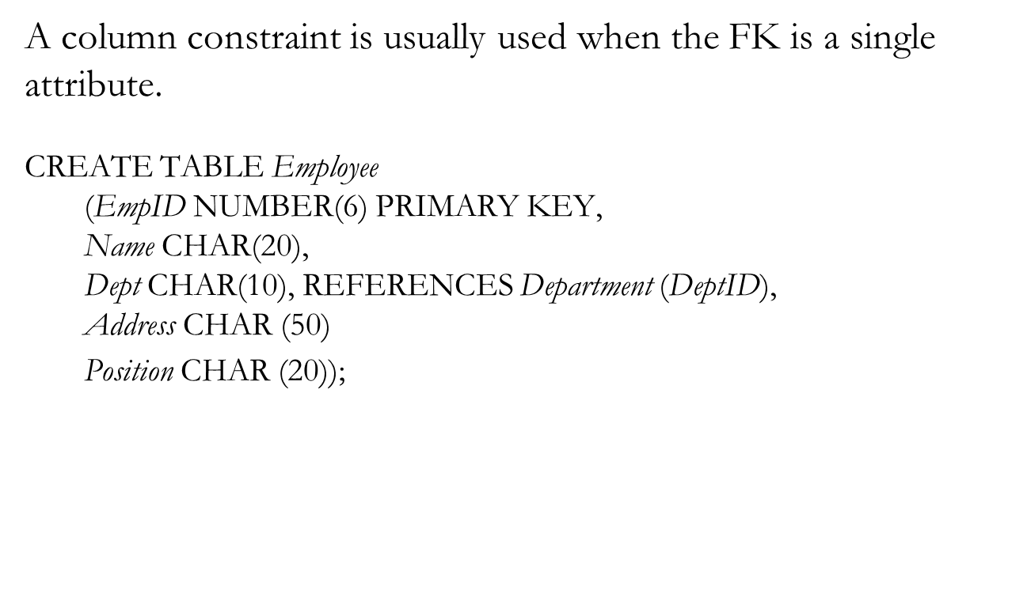
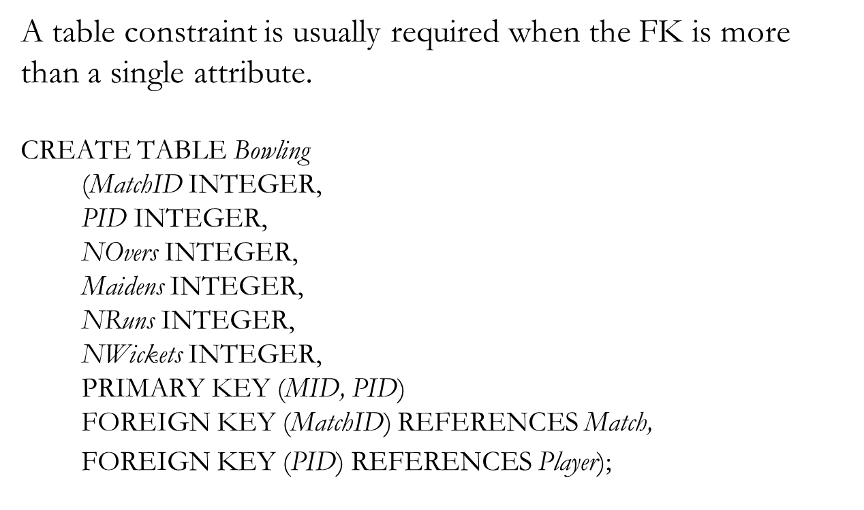
Foreign key as column and table constraints

Slide 38
Orders
O_ID ORDER_NO C_ID
1 2253 3
2 3325 3
3 4521 2
4 8532 1

Slide 39
Customers
C_ID NAME ADDRESS
1 RAMESH DELHI
2 SURESH NOIDA
3 DHARMESH GURGAON

Slide 40
CREATE TABLE Orders
(
O_ID int NOT NULL,
ORDER_NO int NOT NULL,
C_ID int,
PRIMARY KEY (O_ID),
FOREIGN KEY (C_ID) REFERENCES Customers(C_ID)
)

Slide 41
Person
PersonID | LastName | FirstName | Age
1 | Hansen | Ola | 30
2 | Svendson | Tove | 23
3 | Pettersen | Kari | 20
Order
OrderID | OrderNumber | PersonID
1 | 77895 | 3
2 | 44678 | 3
3 | 22456 | 2
4 | 24562 | 1

Slide 42
CREATE TABLE Order (
OrderID int NOT NULL,
OrderNumber int NOT NULL,
PersonID int,
PRIMARY KEY (OrderID),
FOREIGN KEY (PersonID) REFERENCES Person(PersonID)
);

Slide 43
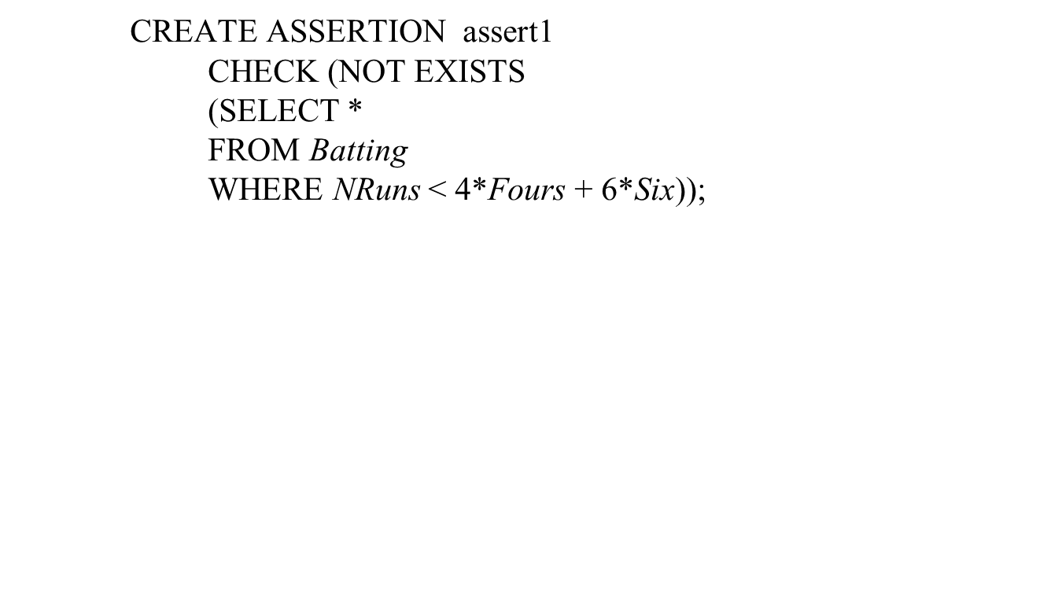
Assertion Constraints

Slide 44
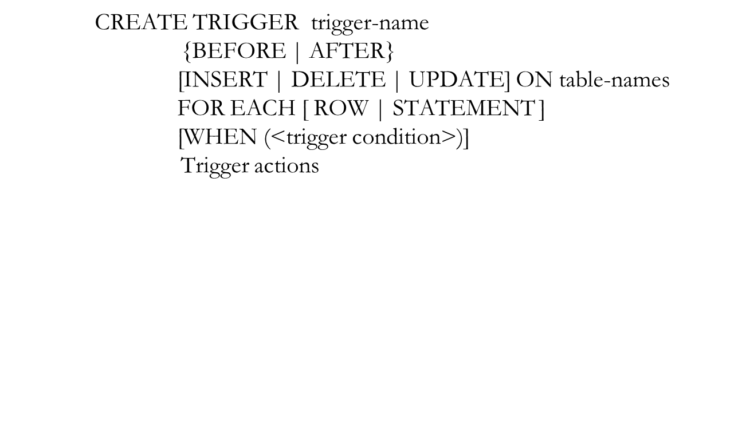
Trigger Constraints

Slide 45
Thank you !

